Slide 1
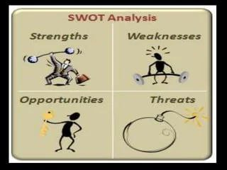
Situational Analysis
By: Dr. Ibtisam Merghani Osman
MBBS, DPH, MPH, MD

Slide 2
Introduction to Situational Analysis
Definition: Situational analysis involves assessing a particular situation or
environment to identify key factors, challenges, and opportunities.
Importance in Healthcare:
Understanding health needs of populations
Identifying gaps in healthcare services
Informing decision-making in policy, programs, and treatments

Slide 3
Key Components of Situational Analysis
Context: Understanding the healthcare environment (e.g., infrastructure, resources).
Stakeholders: Identifying key people/groups involved (e.g., patients, healthcare providers, policymakers).
Data Collection: Gathering relevant data (e.g., health statistics, patient outcomes, surveys).
Analysis: Evaluating the data to identify problems, trends, and opportunities.

Slide 4
Steps in Situational Analysis
Define the Problem: What is the issue at hand (e.g., rise in a specific disease)?
Collect Data: Gather qualitative and quantitative data (e.g., health records, interviews).
Analyze the Data: Examine patterns, trends, and outliers in the data.
Identify Key Issues: Highlight the most pressing concerns (e.g., access to care, disease prevalence).
Formulate Solutions: Develop recommendations based on the analysis.
Plan Implementation: Create actionable strategies for addressing the issues.

Slide 5
Types of Situational Analysis in Healthcare
Health Needs Assessment:
Identifying the health needs of a population.
Example: Assessing vaccination coverage in a rural community.
SWOT Analysis (Strengths, Weaknesses, Opportunities, Threats):
Evaluating internal and external factors influencing healthcare delivery.
Example: SWOT of a local hospital's emergency department.
PESTLE Analysis (Political, Economic, Social, Technological, Legal, Environmental):
Evaluating external factors affecting health outcomes.
Example: Impact of government policies on mental health care access.

Slide 6
Data Collection Methods
Primary Data:
Surveys, interviews, and observations.
Example: Conducting patient satisfaction surveys at a hospital.
Secondary Data:
Reviewing existing records, reports, and health statistics.
Example: Analyzing national health survey data to identify trends in diabetes.
Qualitative Data:
Patient interviews or focus groups to understand experiences.
Quantitative Data:
Statistical analysis of patient outcomes, disease prevalence, etc.

Slide 7
Analysis Techniques in Healthcare Situations
Descriptive Statistics:
Summarizing and understanding data distributions (e.g., mean, median, mode).
Trend Analysis:
Identifying long-term patterns in health data (e.g., increasing incidence of chronic diseases).
Risk Assessment:
Estimating the likelihood and impact of health risks (e.g., outbreak prediction).
Predictive Analytics:
Using historical data to forecast future trends (e.g., predicting disease outbreaks or hospital readmission rates).

Slide 8
Identifying Key Issues in Healthcare Situations
Health Inequities:
Disparities in access to healthcare based on socioeconomic status, race, or geography.
Disease Outbreaks:
Evaluating factors contributing to the spread of infectious diseases.
Healthcare Access and Quality:
Assessing barriers to care such as cost, distance, or availability of services.
Healthcare Workforce:
Analyzing workforce shortages, training needs, and capacity.

Slide 9
SWOT Analysis in Healthcare
Strengths: What does the healthcare system or facility do well?
Example: Highly skilled medical staff, well-equipped facilities.
Weaknesses: Areas that need improvement.
Example: Long wait times, insufficient funding.
Opportunities: External factors that can be leveraged.
Example: New healthcare technologies, government funding for disease prevention.
Threats: External challenges or risks.
Example: Rising healthcare costs, political instability, public health crises.

Slide 10
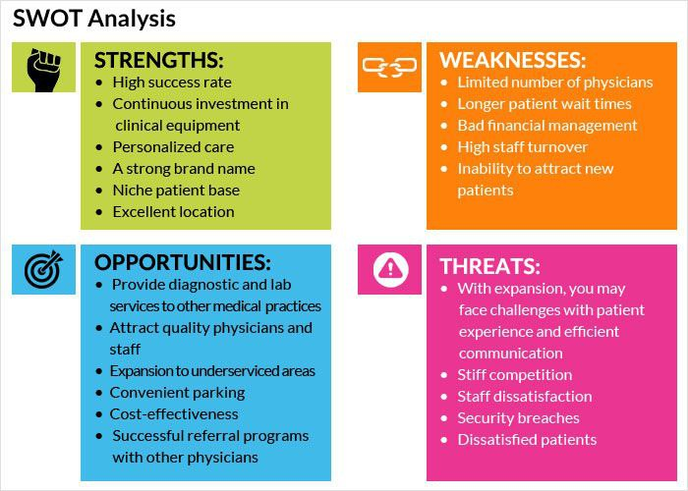
SWOT Analysis in Healthcare

Slide 11
PESTLE Analysis in Healthcare
Political: Government policies, healthcare regulations, public health initiatives.
Economic: Funding availability, cost of treatments, economic disparities.
Social: Public attitudes toward health issues, cultural norms, health education.
Technological: Advancements in medical technology, electronic health records, telemedicine.
Legal: Health laws, patient privacy, liability issues.
Environmental: Climate change, natural disasters affecting healthcare delivery.

Slide 12
Case Study: Situational Analysis of a Health Crisis
Scenario: A sudden outbreak of a contagious disease in a region.
Steps:
Define the Problem: Assessing the outbreak’s scope and impact on the community.
Data Collection: Gathering case reports, demographic data, and healthcare infrastructure capacity.
Analysis: Identifying trends in spread, identifying at-risk groups.
Key Issues: Lack of medical supplies, shortage of healthcare workers.
Solutions: Rapid response plan, vaccine distribution, public health education.
Implementation: Coordinating with local government, healthcare organizations.

Slide 13
Ethical Considerations in Situational Analysis
Confidentiality: Protecting patient privacy when handling data.
Bias: Ensuring that the analysis is free from personal or societal bias.
Transparency: Clear reporting of methods and findings.
Informed Consent: Obtaining consent when collecting data from individuals.

Slide 14
Challenges in Situational Analysis
Data Quality: Inaccurate, incomplete, or biased data.
Resource Constraints: Limited access to healthcare facilities, funding, and expertise.
Cultural Sensitivity: Addressing the diverse needs of different population groups.
Political and Social Barriers: Resistance from stakeholders or conflicting interests.

Slide 15
Conclusion
Summary: Situational analysis is crucial in understanding healthcare problems and making informed decisions to improve outcomes.
Key Takeaways:
Always consider multiple factors—context, stakeholders, data—when analyzing health situations.
Use appropriate tools (e.g., SWOT, PESTLE) to guide analysis.
Ensure ethical practices and data integrity throughout the process.

Slide 16

Questions and Discussion

